Slide 2
Support at Arcada
2026-27
Support in studying
Health and Well-being
Safety and security
Career support
Library

Slide 3
1. Support for studying
Counselling for studying
How can I get my studies done?
“I do not understand anything” – who can I talk to?
How can I improve my study techniques?
How can I plan my every-day-life and studies better?
→ Be in contact with Erika Nyström

Slide 4
Individual study arrangements
Do you have dyslexia, ADHD/ADD or other challenges with studying and need individual study arrangements?
Information about certificates:
Thursday 3.9 at 11 online
For more information and a link to the online session, please contact maria.hoglund@arcada.fi

Slide 5
2. Health and well-being
Student healthcare (FSHS)
  Physical and mental health
  Medication and assessments
  Dental care
  Do not forget the healthcare fee to KELA (DL 30.9)
Psychologist at Arcada
  Mental health
  Support (anxiety, depression, relationships, worry etc.)
  Also available for open path students
  → Be in contact with Maria Höglund

Slide 6
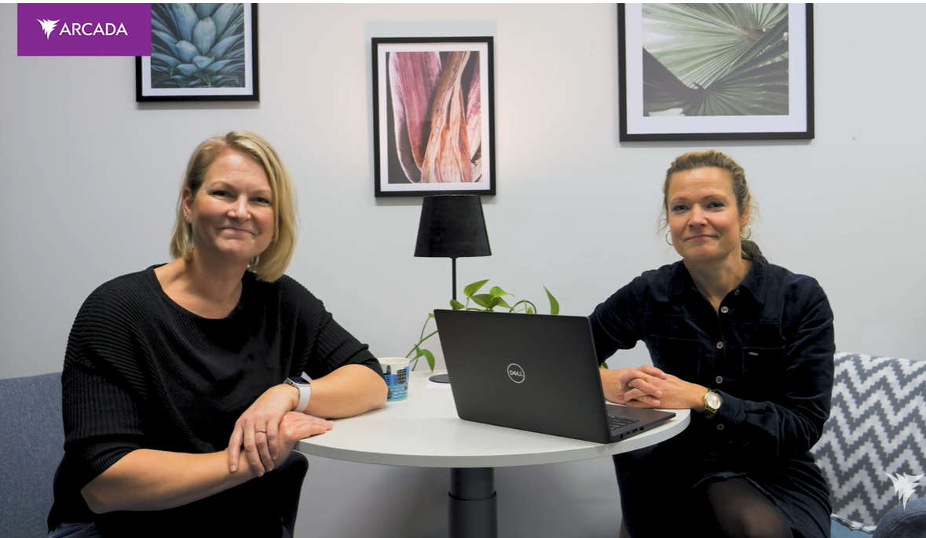
How can I book a session?
firstname.surnamn@arcada.fi
counselling@arcada.fi
Erika’s WhatsApp
050 408 1338
Reception in the Library, C2 or online
Maria Erika

Slide 7
3. Safety and security
Falcony tool
    Harrassments, accidents, equality, accessibility etc.
    Feedback
    Link on start
    Student representative
    → maria.hoglund@arcada.fi
Safety and security

Slide 8
Other places to turn to when you need support:
Sveps
Helsinki Missio
More alternatives on Tuudo
Student chaplain

Slide 9
Save the date:
Well-being fair:
Thu 8.10 at 11-13
At the big square at Arcada
Walk-in therapy
(co-operation with Stationens barn)
C1, August 28th →

Slide 10
4. Career Centre
Elena Ehrl, elena.ehrl@arcada.fi
Inga Chernova, inga.chernova@arcada.fi
Career counsellors
C244 (Library)

Slide 11

What is Career Centre?
Career Centre is a "place" where students of Arcada recieve guidance on the matters of their careers.
We organize career-related events and provide counselling at the center and online, both individually and in groups.
Career Club - last Tuesday of the month, 16:15
CV & LinkedIn photo-shoots
Job Sprint with invited recruiters
Drop-ins – quick questions and CV checks

Slide 12
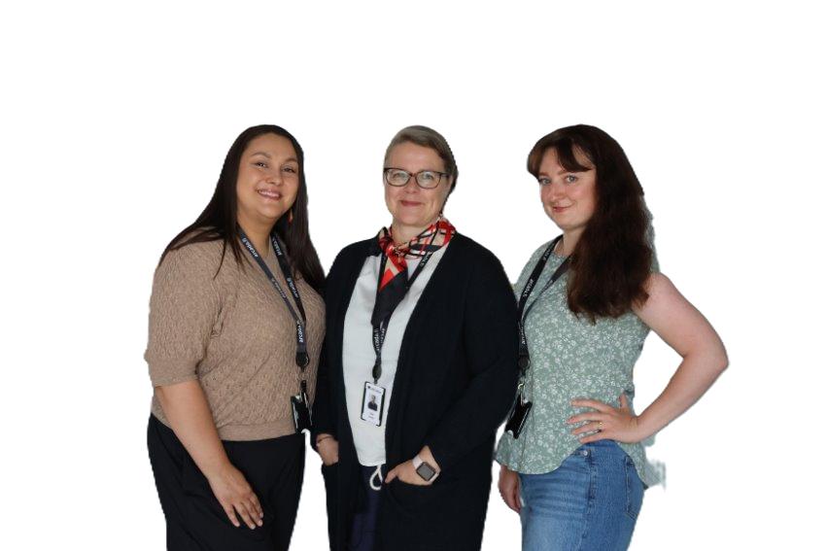
Contact a career counsellor to
...plan your career path(s):
Learn what jobs can you get and what do employers expect to see.
Understand your skills better – what makes you unique? Why will you stand out among 200 applicants?
Boost your presentation skills and learn about the main job-seeking tools and processes:
  CV och Cover Letter
  LinkedIn
  Job Applications (active & passive)
  Interview techniques
  Networking
Inga, Ulla, & Elena, Career Centre

Slide 13
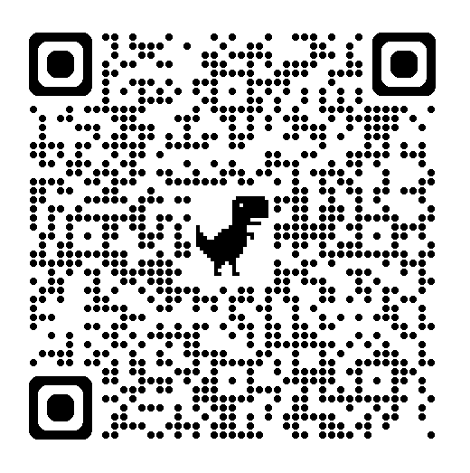
Book your first counselling!
Pro.vello.fi/arcada/ => Career Centre
Or start.arcada.fi> Study support > Career services

Slide 14
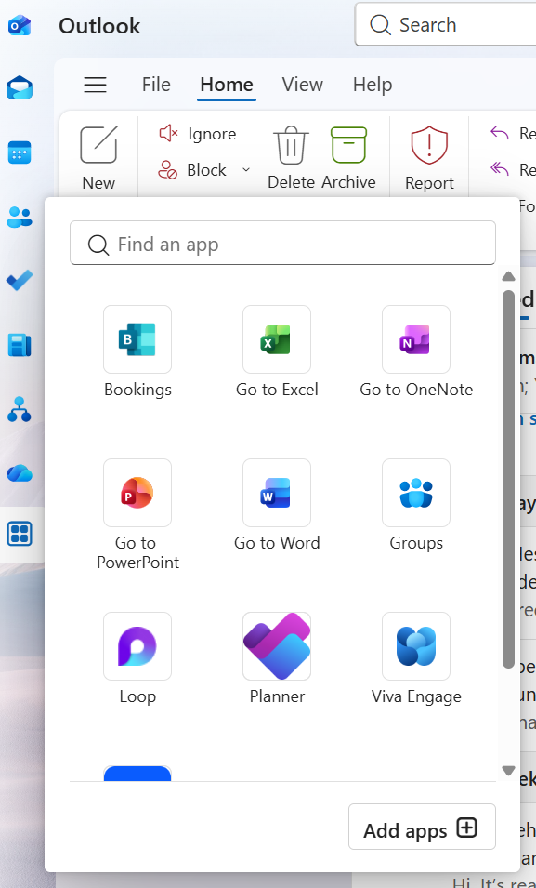
New booking system soon TBA!
Microsoft Bookings
Arcada Karriärcentret / Career Centre

Slide 15
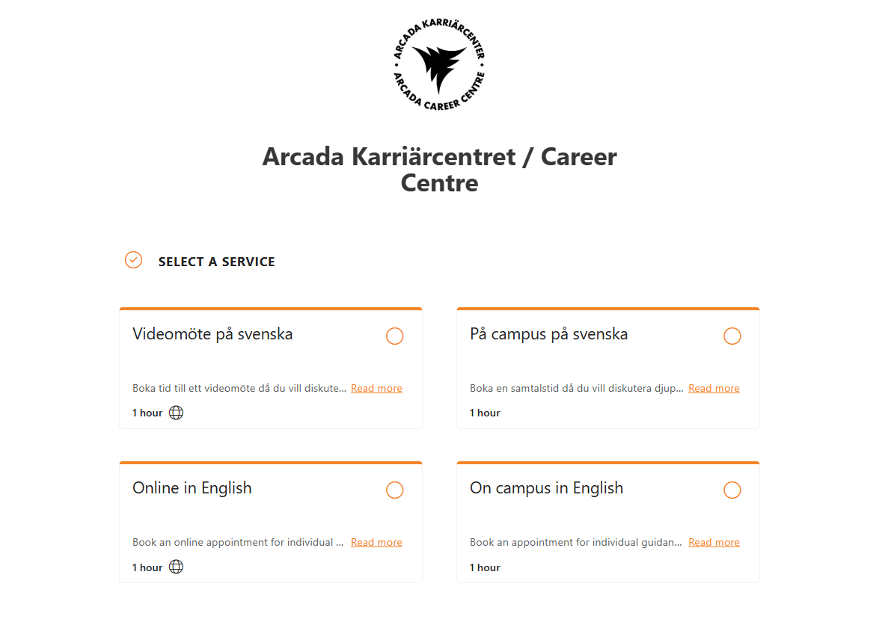

Slide 16
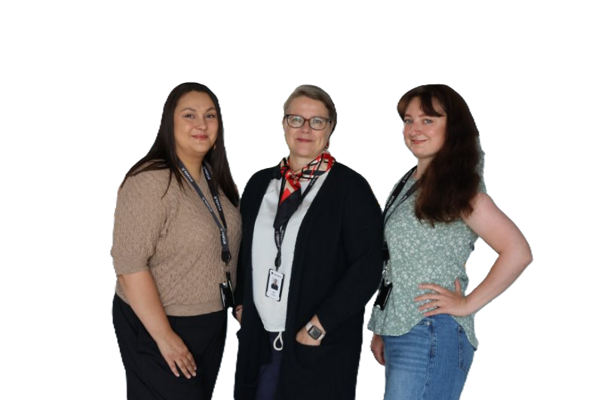
Keep up to date!
Welcome to our drop-ins
Tuesdays 11:30 – 13:00!
Follow us on Instagram:
@karriarcenterarcada
Follow us on LinkedIn: Karriärcenter Arcada

Slide 17
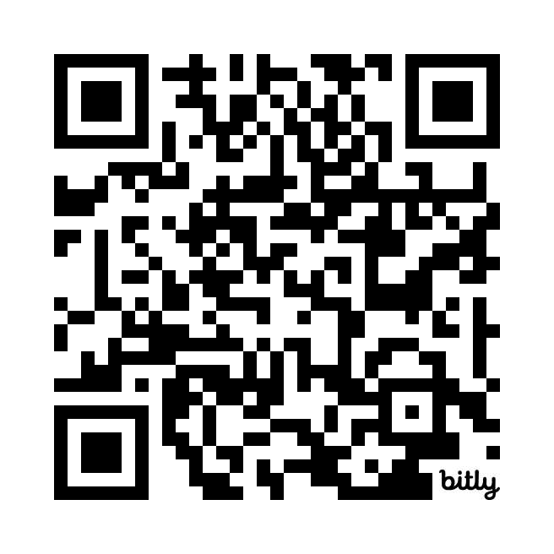
Job Portal
arcada.jobteaser.com/en
Log in with your Arcada ID
492 registered companies
~25 % English speaking jobs
Full & part time employment,
summer jobs, practical training, subject for thesis
Recruitment events and
resources for job seeking
NB! Tuudo - the Arcada app & Jobiili

Slide 18

My Future Work recruitment fair
Save the date:
13.1.2027 at
the Big Square

Slide 19
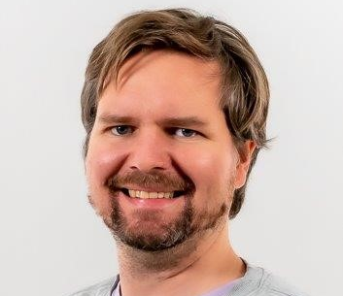
Our international student advisor
Laurits Møller
Ph: 0294 2282 560
Mail: laurits.moller@arcada.fi,
Room: C244 (in the library)
https://start.arcada.fi/en/study-support/for-international-students

Slide 20
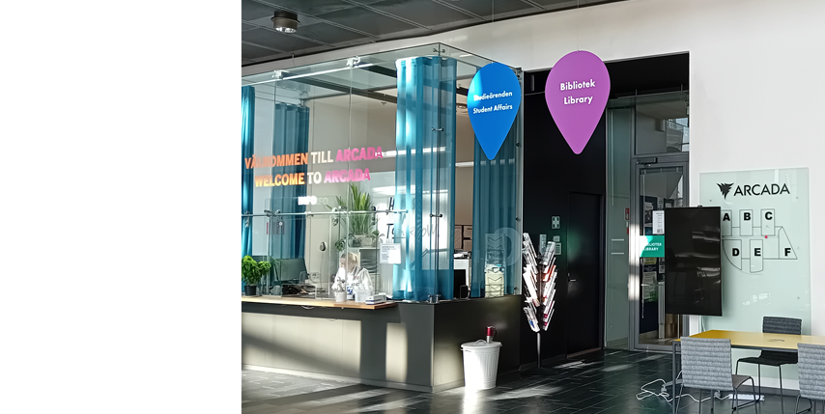
5. The Library
Jonna Vocke: Head of information management
Ina Antell: Librarian
Sofia Nordberg: Information specialist
Janne Nyström: Information specialist
Tomas Rönn: System developer

Slide 21
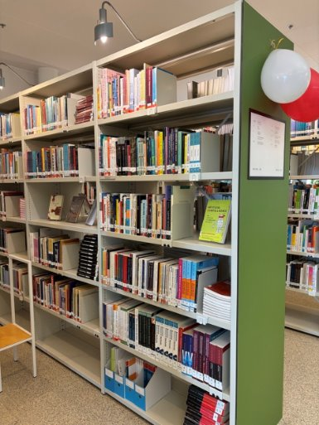
More than bookshelves
Books, magazines, papers, e-books, e-magazines, databases
Open weekdays: 7-20:30, Customer service: 10-15
Teaching
Interlibrary loans
Publications
Open science

Slide 22
Support in information retrieval
Writing workshops on Tuesday 14-16 at the library (from 15th September onwards)
Individual guidance:
informationspecialist@arcada.fi (or through link at Arcada Finna)

Slide 23
Where do I find more information?
START
Tuudo
Karriärcentret
Arcada Job portal
The Library
Sveps
Student healthcare
Notes:
Nyyti can be mentioned.

Slide 24
Warmly welcome and good luck with your studies!

