Slide 2
Start of studies
Camilla Genberg Sofie Sundström Laurits Møller
Study Counsellor Study Counsellor International Student Advisor
International Business Mechanical and Sustainable Engineering
Notes:
We are here today to provide practical information about the start of your studies.
The introductions days are held for first-year bachelor's students 23–30 August 2024. This first introduction day (23 August) is only aimed for our new international students.

Slide 3
Structure of the session
Presentation – who are we?
Today’s schedule
Schedule for next week
International House Helsinki
Migri
Student Affairs
Questions
Notes:
The topics of this session are:
International House Helsinki - an official regional service for international newcomers
Migri – the Finnish Immigration Service – Maahanmuuttovirasto in Finnish

Slide 4
Study Counsellors
We provide advice and guidance in planning personal study plans.
Notes:
Basically we provide guidance for planning your studies.
Do you need help planning your studies?
Please contact the study counsellor for your programme. The study counsellor knows the structure and content and is able to help you plan you studies.
When to contact your Study Counsellor
If you have study related questions about your study plan
If you want to study faster and need an individual study plan
If you have fallen behind in your studies Application for accreditation

Slide 5
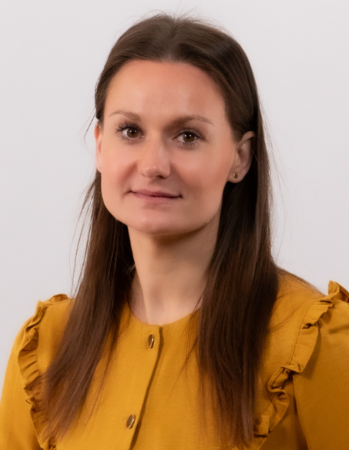
Contact information
Camilla Genberg, MAEd.
Study Counsellor
International Business
+358 (0)294 282 672
camilla.genberg@arcada.fi

Slide 6
Contact information
Sofie Sundström
Study Counsellor
Mechanical and Sustainable Engineering
+358 (0)294 282 651
sofie.j.sundstrom@arcada.fi

Slide 7
International Student Advisor
I provide advice and guidance for newcomers in Finland.

Slide 8
Contact information
Laurits Møller
International Student Advisor
+358 (0)294 282 560
laurits.moller@arcada.fi
Room C244 in the Library
https://start.arcada.fi/en/study-support/for-international-students

Slide 9
Today's Schedule
Time | Programme | Room
9.00-9.15 | Welcome to Finland! | Small Auditorium (F249)
9.15-10.15 | Practical information about the start of studies | Small Auditorium (F249)
10.30-11.30 | Life and studies in Finland & cultural adaptation | Small Auditorium (F249)
11.30-12.00 | Tuition fees and scholarships | Small Auditorium (F249)
12.00-13.00 | Lunch
13-14 | It-dropin, stamping of meal subsidy cards and HSL certificates, mingle with tutors, handing in of certificates | Pacius (It-dropin), Big Square (stamping and mingle), Info desk (keys)

Slide 10
Schedule for August 26th, 27th, 28th and 29th
FOUND ON START!
International Business
Mechanical and Sustainable Engineering
This is Arcada & Arcada Student Union ASK
Presentation of the Degree Programme
Session with the Study Counsellor & Course enrollment
Digital Tools
Student Affairs
Tutors & Student Association
Notes:
During the introduction days students get acquainted with the Arcada building as a learning environment, their new degree programme, and get to meet their teachers, study counsellors and tutors who will help them get started with their studies at Arcada. During next week introductory sessions will be held alongside regular lectures as well.

Slide 11
IB - Schedule for 26-27.8
Monday 26.08.2024:
09.00 – 09.45 Information about the Degree Programme - B518
10.00 – 11.15 Session with the Study Counsellor - E383
11.15 – 12.00 This is Arcada & Arcada Student Union ASK - Small Auditorium F249
12.00 – 13.15 LUNCH
13.15 – 13.45 Campus tour with the tutors - B518
13.45 – 14.15 Trade and Services Student Association HanSe & visit to the Cor-house - B518
Tuesday 27.08.2024:
10.00 – 10.45 Digital Tools - E383
11.00 – 11.30 Student Affairs & Library – Small auditorium F249
11.30 – 12.15 LUNCH
12.15 – 15.00 Amazing Business Race - Big Auditorium F143

Slide 12
IB - Schedule for 28-29.8
Wednesday 28.08.2024:
10.15 – 11.15 Global Competences - Big Auditorium 143
11.15 – 12.15 LUNCH
12.15 – 13.45 Introduction to Business Administration - A409
14.30 – 15.30 Language Information – Small Auditorium F249
Thursday 29.08.2024:
09.00 – 10.00 Support in Studies - Small Auditorium F249
10.15 – 11.45 Business Mathematics and Statistics - B518
11.45 – 12.15 LUNCH
12.15 – 13.45 Technology and Learning - Big Auditorium F143

Slide 13
MSE - Schedule for 26-27.8 (on campus)
Monday 26.8.2024:
10.00 – 11.00 Presentation of the Degree Programme – D4107-08
11.15 – 12.00 This is Arcada – Vice Dean + Arcada Student Union ASK – Small Auditorium F249
12.00 – 13.00 LUNCH
13.00 – 13.30 Tutors and Student Association TLK – B522
13.45 – 15.00 Course enrollment and Digital Tools with the Study Counsellor and
International Student advisor– B522
Tuesday 27.8.2024
10.00 – 11.45 Drop-in session for students who need help with the course enrollment – E387
11.00 – 11.30 Student Affairs and Sisu – Small Auditorium F249
11.30 – 12.30 LUNCH​
12.30 – 13.30 Guided tour and other programme with the tutors – Entrance, Level 1
13.45 – 14.45 Studying at Arcada – B518

Slide 14
Programme on 28-30.8.2023 (next week)
The lectures will start
You will receive the schedule for next week when you have signed up for courses
Information sessions
Language Studies
Support in Studies
Global Competences
MSE students: A session about accreditations on Friday

Slide 15
International House Helsinki
International House Helsinki provides a wide range of information and public authority services to meet the needs of international newcomers in the Helsinki capital region.

Slide 16
International House Helsinki
IHH is the main entry point for international newcomers to start their life in the Helsinki capital region, and the next step after applying for a residence permit. International newcomers can visit multiple authority services (including Migri, DVV, Vero, Kela, the TE office, and more) under one roof at IHH’s service centre for a streamlined integration experience.

Slide 17
International House Helsinki
At International House Helsinki (IHH), the cities of Helsinki, Espoo, and Vantaa provide general information and guidance across many topics.
Whether you have questions about city services, need help understanding the procedures of different authority services, or more, use our general information and guidance for help.
All services at IHH are free of charge.

Slide 18
Newcomer’s Guide
Latest edition of Newcomer’s Guide
It includes guidance on e.g.
Bank account
Mobile phone subscription
Early childhood education (daycare)
Renting an apartment
Health services and medical care
Public transportation
Free-time activities
Notes:
If you are looking for information about moving to, living, working, studying and enjoying life in the Helsinki Capital region the Newcomer’s Guide is an excellent source of information.
The guide includes guidance on taking care of official and personal matters, and provides contacts to related public services that you might need.

Slide 19
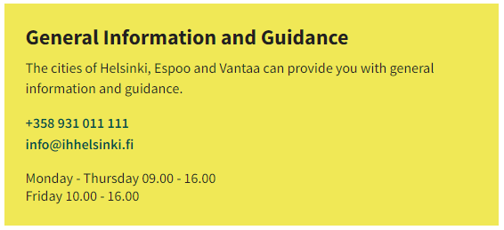
IHH - General information and guidance services
Notes:
https://ihhelsinki.fi/guidance-and-support-services/general-information-and-guidance/

Slide 20
IHH – Specific desk services

Slide 21
MIGRI – Finnish Immigration service
All questions regarding residence permits should to be directed to Migri.
https://migri.fi/en/
Don't forget to inform Migri in case your life circumstances change in a way that affects your ability to fulfil the requirements of your visa, e.g. parental leave, serious illness etc
Notes:
Har du något att komma med här Laurits? Vill du exempelvis säga i vilka uppehållstillståndsärenden du kan hjälpa?

Slide 22
Student Affairs
Tuition fees
Scholarships
Registration for the academic year
studentaffairs@arcada.fi
Wednesdays 10-12 in room C244 in the Library
Thursdays 12-14 by phone 029 4282 535
Notes:
Visiting hours found on START.

Slide 23
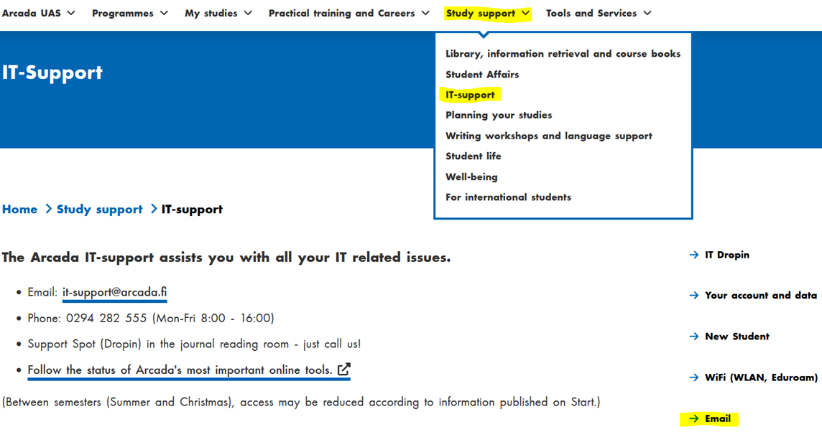
Arcada Email Account
Start using your Arcada email account now!
http://outlook.arcada.fi
How to configure your Arcada email on your laptop or phone? > Check instructions on start.arcada.fi > Study support- It-support-Email
https://start.arcada.fi/en/study-support/it-support/email

Slide 24
Questions?

Slide 25
Thank you!
Have a lovely day!

